Slide 1
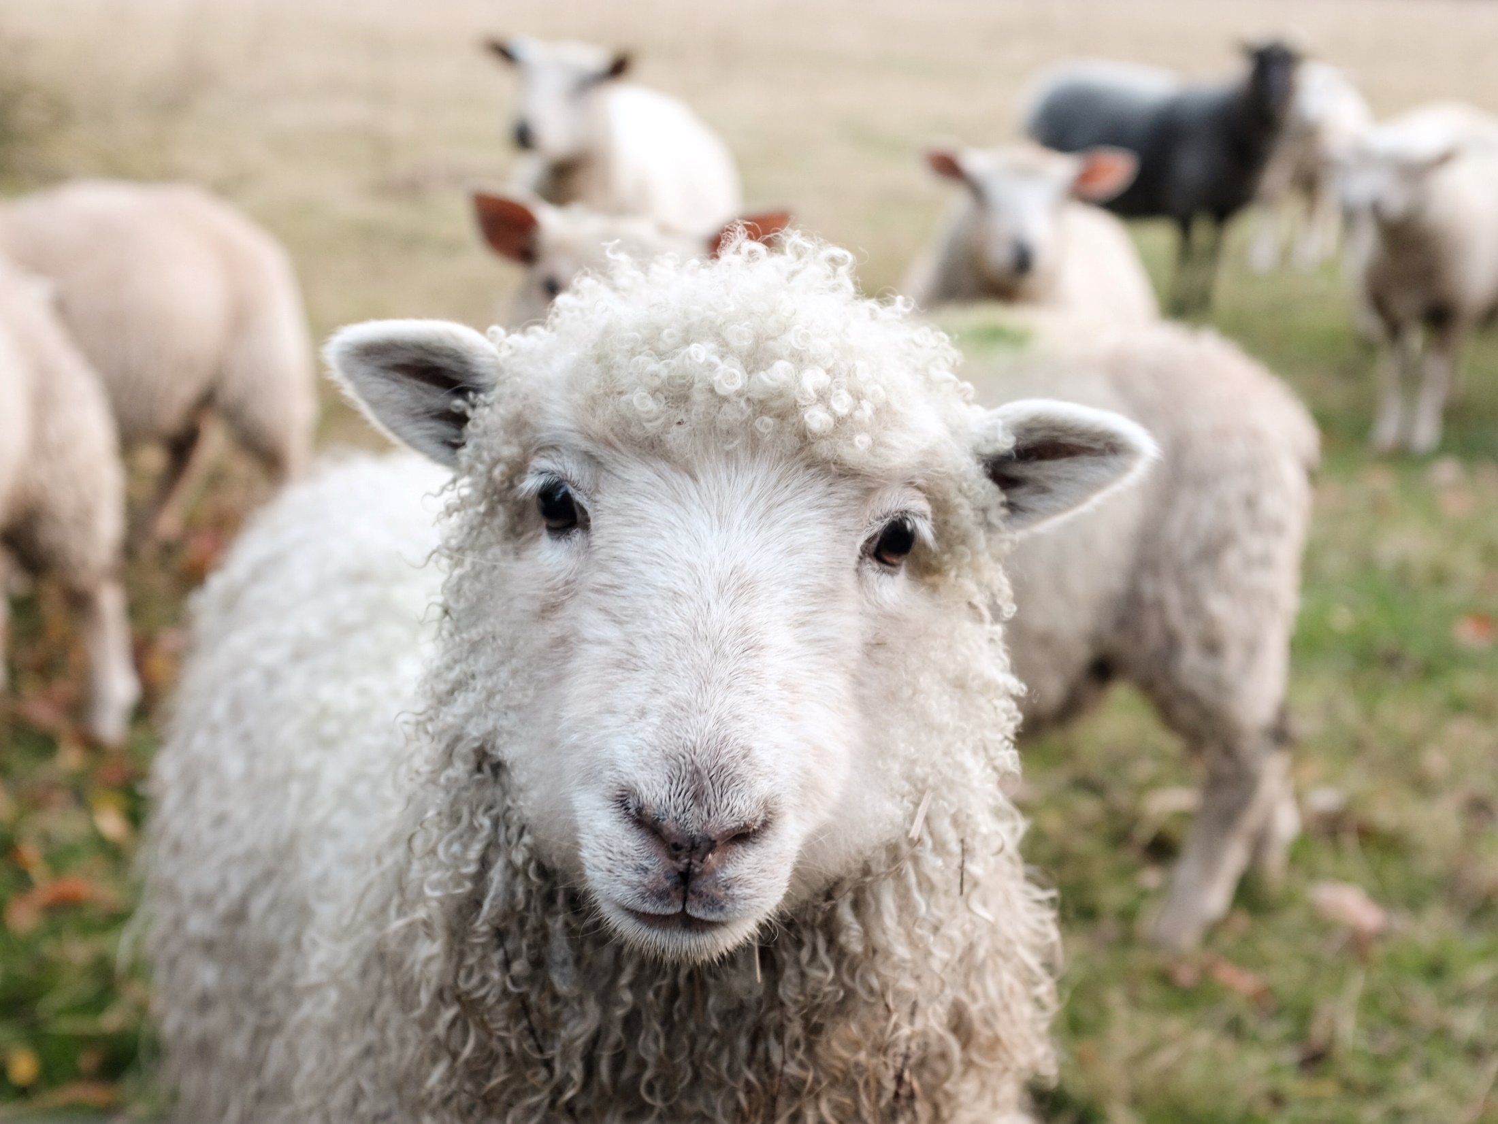
TouchPoints Perspective:
Framing Sustainability
Gabriela Cropper

Slide 2
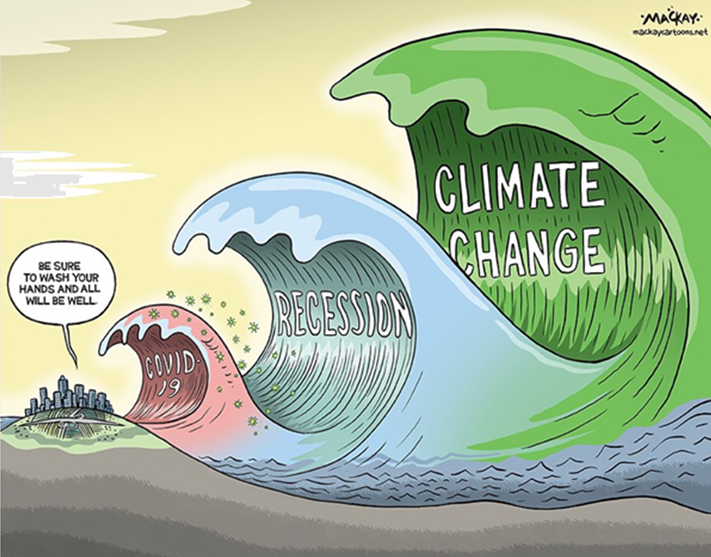
Introduction
Sustainability in current times
TouchPoints 2020 pre and post lockdown data shows a rise in consumer consciousness:
73% of all adults agree that it bothers them when manufacturers use a lot of unnecessary packaging
+24% people avoid unethical brands
+21% prefer to eat organic food
+13% are worried about the pollution and congestion caused by cars
+24% actively avoid shops that they feel are unethical

Slide 3
Introduction
Framing sustainability
This prompts us to take a step back and ask:
How do people form opinions about climate change and sustainability?
What are the driving factors forming people’s ideas of sustainability?
How can we leverage these factors to drive sustainability awareness and behaviours?
How can we best communicate about sustainability to different audiences?
What are the benefits of framing sustainability messages so they chime with more specific views and opinions?
What are the risks of alienating audiences with generalising sustainability messaging?

Slide 4
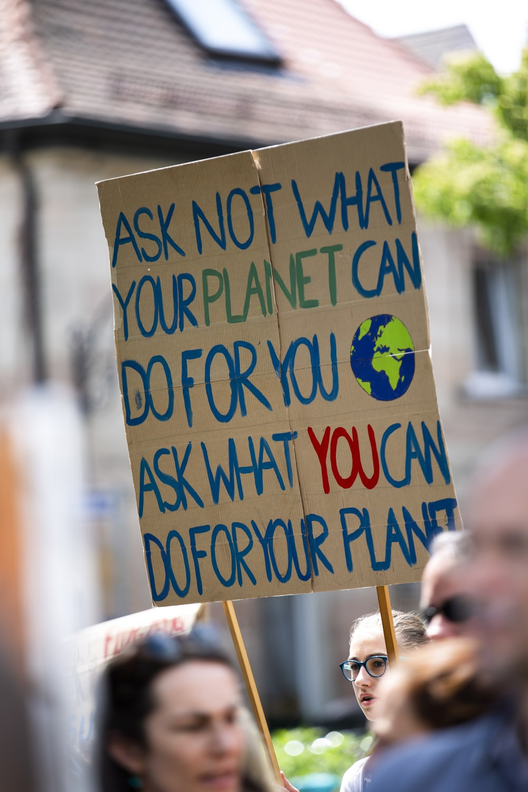
Background
Framing sustainability
The sociological school of thought looks at the impact social influences and ideologies on climate change scepticism.
Social and political drivers: human values and political orientation i.e. individualism, anthropocentrism, socialism
Demographic factors: gender, age, social grade, education
Academics generally find political orientation is amongst the most important drivers affecting views on climate scepticism
Notes:
https://unsplash.com/photos/FLGOQ1Kgn_E

Slide 5
Background
Framing sustainability
Principles of cognitive psychology that look at the brain’s predispositions to underestimate the urgency of climate change
Loss aversion: we are less willing to address a distant problem that requires sacrifices now to avoid uncertain losses far in the future
Cognitive dissonance: when an individual responds an opposing cognition with a justification that matches their existing belief system and may compromise the truth
Motivated reasoning: we are more accepting of evidence that confirms our beliefs, rather than evidence that discomforts them
Notes:
Lavandera and Morris (2017)

Slide 6
Background
Loss aversion
“We have a brain that is very good at detecting and deflecting threats, so why not global warming? It's because our brain isn’t evolved to treat threats the same way.
Global warming is a threat to our tomorrow but it's not a threat to our evening.”
Daniel Gilbert
Notes:
Gilbert outlines four triggers (intentional, immoral, imminent and instantaneous) necessary to cause a change in reaction, none of which are present in global warming. The latter two feed into to the bias of loss aversion. https://vimeo.com/10324258

Slide 7
Background
Cognitive dissonance
Notes:
One of the fishermen explains he would only accept climate change if a 500-year-old scientist would tell him it was happening.
This could be a way to attempt to reduce or change the dissonance in the mind of the fishermen since his request is impossible.
Thus, by altering the contradicting dissonance, he is able to distort the validity of scientific finding by limiting the findings, while simultaneously requiring additional information that is unobtainable.
As a result, the fisherman’s beliefs remain intact and unrefuted.

Slide 8
Background
Motivated reasoning
“Those with greater prior scepticism about climate change rated the sceptical editorial as more convincing and more reliable than the pro-climate change editorial (and vice versa for less sceptical participants).”
Corner, Whitmarsh and Xenias (2012)
Notes:
Adam Corner, Lorraine Whitmarsh & Dimitrios Xenias (2012)
Uncertainty, scepticism and attitudes towards climate change: biased assimilation and attitude polarisation
Participants seemed to evaluate the convincingness and reliability of the editorials according to their existing attitudes: those with greater prior scepticism about climate change rated the sceptical editorial as more convincing and more reliable than the pro-climate change editorial (and vice versa for less sceptical participants).

Slide 9
Background
To answer these questions
We collated all sustainability statements in TP 2019
We created political proxies based on the VO lifestyles
We ran statements against various demographics to account for top priorities
We plotted statement indexes on a scatter graphs to identify clusters

Slide 10
Background
To answer these questions
I Try To Buy Local Produce Whenever I Can | I Am Worried About the Pollution and Congestion Caused By Cars
I Prefer Not To Buy Food That Has Been Genetically Modified | I Am Concerned About the Effects of Climate Change
I Am Trying To Buy More Fair Trade Products | I Actively Avoid Shops I Feel Are Unethical
I Am Actively Reducing The Amount Of Plastic I Use | Where and How a Product Is Made Is Very Important To Me
I Am Happy To Pay More For Locally Produced Items | I Prefer To Use Independent Shops For Fresh Produce Rather Than Supermarkets (e.g. Butcher, Fishmonger etc.)
I Have Consciously Reduced The Amount Of Meat I Am Consuming | I Like To Get Out To the Countryside Whenever I Can
I Prefer To Use Brands That Have A Clear Social Conscience | It Is Important For Me To Know How The Products And Services I Buy Are Sourced And Made
Notes:
The statement span across various aspects of sustainability, including local support to business, provenance/sourcing and social consciousness (i.e. reducing meat/plastic usage, buying fair trade, concerns for climate change etc.).

Slide 11
Background
Defining political proxies
Political proxies were created based on the Views and Opinions statements reflecting conservative and liberal attitudes:
Traditionalism
Brexit
Openness to different cultures
Newspaper readership

Slide 12
TouchPoints analysis: Demographics

Slide 13
Attitudes: women vs men
Top statements for men and women are the same:
Countryside
Reducing plastic usage
Local produce premium
Largest differences in opinion:
Reduce plastic usage
Prefer not to eat GMOs
Reducing meat
Notes:
Considering all sustainability statements, general views for both genders are similar although women have more favourable attitudes than men. Despite plastic reduction ranking the second highest for both genders, women are far more concerned than men on this front. This also transpires in their reluctane to eat GMOs willingness to reduce meat consumption.

Slide 14
Attitudes: social grade
Top statements for ABC1:
Reducing plastic
Countryside
Local produce premium
Top statements C2DE
Countryside
Reducing plastic
Buy local
Largest differences in opinion:
Pay premium for local produce
Preference for brands with a clear social conscience
Buy more fair trade products
Notes:
Here the key difference lies in affordability of local produce. Both social groups are willing to shop locally unless it comes at a premium for C2DEs. Both groups clearly appreciate the countryside and are also actively reducing the use of plastic.
Other differences are noted in terms of pro-social values, where ABC1s tend to voice more positive attitudes towards brands with a social conscience and fair trade products.

Slide 15
Attitudes: age groups
Notes:
In terms of generational trends, we find similar patterns across all three ages groups although the older (55+) tends to score higher on all fronts. The biggest difference lies in local shopping where the 55+ age group show more willingness to pay for local produce. This graph raises interesting questions around the perception of climate action, commonly portrayed as a concern for the younger generations. There appears to be a discrepancy in some sustainable behaviours worth considering for awareness and behavioural change strategies.

Slide 16
Attitudes: The Guardian vs The Telegraph readers

Slide 17
Attitudes: The Guardian vs The Telegraph readers
Notes:
In this case we applied The Guardian and The Telegraph readers as proxies to represent right and left-leaning individuals. The results show both audiences are likely to be actively reducing their plastic usage and can afford the premium of local produce. However, largest differences in opinion lie in the support of fair trade products, reducing meat, demands for brand with a social conscience, views towards climate change and avoiding unethical shops. Most of these views reflect differences around socialist values with important implications on the framing of sustainability messages.

Slide 18
Analysis
Similarities and differences
Statements | The Guardian | The Telegraph | Diff.
I Have Consciously Reduced The Amount Of Meat I Am Consuming | 80 | -5 | 85
I Prefer To Use Brands That Have A Clear Social Conscience | 83 | 0 | 83
I Actively Avoid Shops I Feel Are Unethical | 72 | -7 | 79
I Am Trying To Buy More Fair Trade Products | 110 | 33 | 77
I Am Actively Reducing The Amount Of Plastic I Use | 25 | 15 | 10
I Am Happy To Pay More For Locally Produced Items | 33 | 28 | 5
Notes:
The Guardian:
I Am Trying To Buy More Fair Trade Products
I Prefer To Use Independent Shops For Fresh Produce Rather Than Supermarkets (e.g. Butcher, Fishmonger etc.)
Where and How a Product Is Made Is Very Important To Me
I Prefer To Use Brands That Have A Clear Social Conscience
I Have Consciously Reduced The Amount Of Meat I Am Consuming
The Telegraph:
I Prefer To Use Independent Shops For Fresh Produce Rather Than Supermarkets (e.g. Butcher, Fishmonger etc.)
Where and How a Product Is Made Is Very Important To Me
I Am Trying To Buy More Fair Trade Products
I Try To Buy Local Produce Whenever I Can
I Am Happy To Pay More For Locally Produced Items

Slide 19
Analysis
Similarities and differences
Statements | The Guardian | The Telegraph | Diff.
I Have Consciously Reduced The Amount Of Meat I Am Consuming | 80 | -5 | 85
I Prefer To Use Brands That Have A Clear Social Conscience | 83 | 0 | 83
I Actively Avoid Shops I Feel Are Unethical | 72 | -7 | 79
I Am Trying To Buy More Fair Trade Products | 110 | 33 | 77
I Am Actively Reducing The Amount Of Plastic I Use | 25 | 15 | 10
I Am Happy To Pay More For Locally Produced Items | 33 | 28 | 5
Notes:
The Guardian:
I Am Trying To Buy More Fair Trade Products
I Prefer To Use Independent Shops For Fresh Produce Rather Than Supermarkets (e.g. Butcher, Fishmonger etc.)
Where and How a Product Is Made Is Very Important To Me
I Prefer To Use Brands That Have A Clear Social Conscience
I Have Consciously Reduced The Amount Of Meat I Am Consuming
The Telegraph:
I Prefer To Use Independent Shops For Fresh Produce Rather Than Supermarkets (e.g. Butcher, Fishmonger etc.)
Where and How a Product Is Made Is Very Important To Me
I Am Trying To Buy More Fair Trade Products
I Try To Buy Local Produce Whenever I Can
I Am Happy To Pay More For Locally Produced Items

Slide 20
TouchPoints analysis: Scatter graphs

Slide 21
TouchPoints analysis
TouchPoints experiment
We plotted the statements to identify clusters of sustainable statements with the following questions in mind:
Do sustainable statements around provenance and localism resonate more with conservative audiences?
Do sustainable statements reflecting socialist or altruistic values resonate more with liberal audiences?

Slide 22
Analysis
Britain Is Right To Leave the EU
Fair trade
Product source
Product provenance
Unethical shops
Anti GMO
Countryside
Notes:
Brexit is a divise topic so we start to see more of a polarisation here within sustainable statement. For points reflecting pro-social views i.e. climate change, fair trade, unethical shops Guardian readers over index and which is in line with their pro EU views. Product provenance is more of a common ground for in terms of Brexit views – more likely to be supported by Guardian readers.

Slide 23
Analysis
Respect traditional customs
Product provenance
Brand consciousness
Product source
Premium local produce
Anti GMO
Countryside
Concerned about climate change
Reduce plastic usage
Notes:
On the topic of traditionalism, this is less divisive so we see most statements are in the top right corner. Statements around provenance and localism have shift towards the right, which means they are positively in line with respecting traditional customs. Attitudes towards anti-GMOs and meat reduction are the least likely at adhere with traditional views, and unlikely to be supported by Telegraph readers compared to Guardian readers.

Slide 24
Conclusion & implications

Slide 25
Conclusion
Communication implications
There is some evidence of political orientation causing divergence in sustainability priorities
Pro-social statements around ethical duties tend to resonate more with liberal/left audiences
Climate change tends to be less of a priority for conservative audiences but product provenance and buying local is worth considering
The common grounds are plastic reduction and appreciation for the country side and buying local
When communicating about sustainability, it is important to consider people’s political affiliation in order to maximise acceptance and change

Slide 26
IPA Events

Slide 27
Data Literacy Skills Training with your host Graeme Griffiths
Friday 26 June 9:30-11am
We will provide the knowledge and skills to question providers on the provenance of their data, to understand how to spot bogus or unrepresentative data and how to develop a healthy level of data scepticism. We will highlight and explain some of the commonest interpretation mistakes so they can be avoided.
What are the benefits?
Understand what ‘bad data’ looks like.
Confidence to ask the right provenance questions of providers.
How to spot and avoid common data interpretation / presentation mistakes.
Content
Why is data literacy important?
Understanding the importance of design in data sourcing.
Review common interpretation mistakes.
https://ipa.co.uk/courses-qualifications/data-literacy-skills-june/

Slide 28
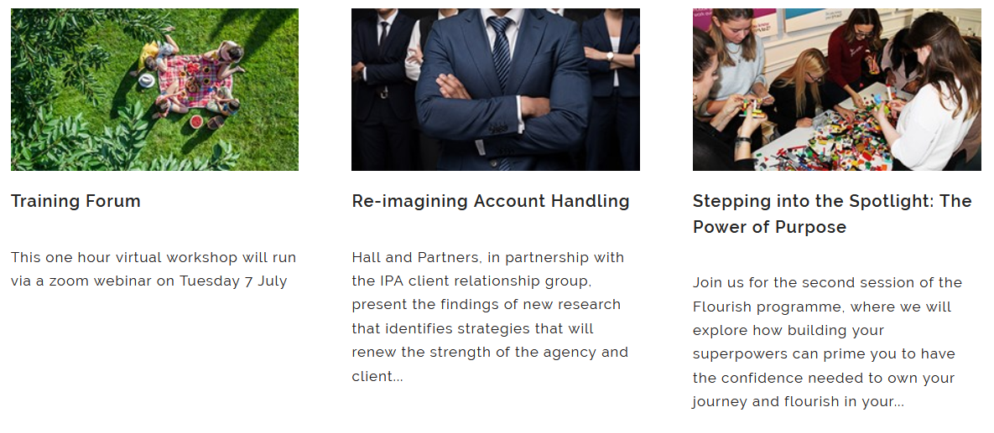
IPA Events Coming Soon
https://ipa.co.uk/events-listing/

