Slide 1


Positive Brand Friction: Generating growth and value from Customer Experience
14 October 2020

Slide 2

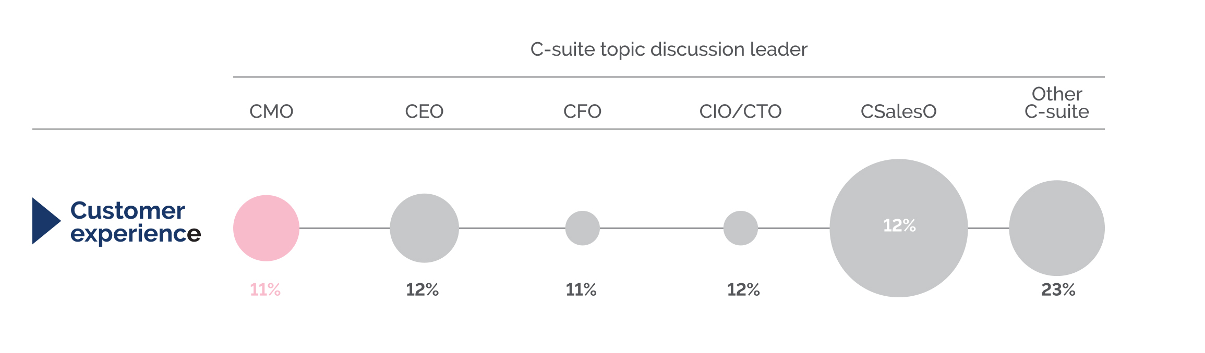
3 reasons why Customer Experience (CX) is interesting
1
Credibility: Sales are over 4x as likely to be seen as the owner of the Customer Experience than Marketing
11%
48%
Source: Deloitte Insights, 2019
Notes:
Looking at survey data from Deloitte Insights it can be seen that there is confusion around who owns Experience within the C-suite and, if Sales is seen as the owner, the lack of clarity about what Experience is and isn’t. Again, this presents an opportunity for the CMO to take an increasingly influential role with regards to Customer Experience in helping define what Customer Experience means to the organisation and positioning it as a vehicle for growth.
• Marketing’s role is to create value. CX can deliver value. It is not just a cost centre.
• CX is an integral part of a brand’s distinctive assets which Marketing need to guide.

Slide 3
3 reasons why Customer Experience (CX) is interesting
2
Focus: Customer Experience is one of the top three priorities for CMOs
Enhance Customer Experience
Drive revenue growth
Develop new products and services
Increase operational efficiency
Improve speed to market
Expand into new markets/geographies
Develop new business models
0
10
20
30
40
50
60
% of CMOs who rank the following in their top three priorities
Source: Gartner Brand Strategy an Innovation Survey, 2019

Slide 4
3 reasons why Customer Experience (CX) is interesting
3
Risk: Given COVID-19, the resistance to risk has been forced lower
Organisational resistance to risk
Inability to measure innovative impact
Limited human resources with necessary skills
Limited technology to support innovation
Limited or lack of budget/funding
Lack of innovation culture
Insufficient leadership vision/strategic focus
None
0
10
20
30
40
50
60
% of CMOs who rank the following barriers in their top three limitations
Source: Gartner Brand Strategy an Innovation Survey, 2019
Notes:
And as this chart demonstrates, organisational resistance to risk can be a major barrier for marketers.
However, the impact of COVID-19 has drastically changed the risk equation, and for many organisations significant change has been necessary for survival. For those reliant on retail, they have had to cope without the facilities to deliver tangible shopping experiences and focus on
improving digital channels before reopening physical channels in a COVID-19 safe way.
As commentators have stated, organisations have had to change Experience priorities in a heartbeat and operate with greater enforced agility, focus, and leanness to keep delivering; a level of change that would have taken much longer to reach in a ‘normal’ environment.
The delivery of quality, brilliant experiences is going to be more important than ever to meet the changing consumer behaviours and for organisations to unlock or re-find their value potential. The role of Marketing within this is critical, as it looks to take a more influential role with Experience and forces greater collaboration across the organisation to be more aligned and integrated in planning, delivering and managing key experiences.
In order to do this, Marketing needs to better step up to the Experience plate, become more involved, take a leadership position in Experience and help drive their organisation’s Experience agenda.
The IPA EffWorks initiative decided to look at this further to help understand how marketers could drive the changes needed.

Slide 5
Five key research objectives
1
Redefine and segment Customer Experience
2
Identify the key tensions restricting growth
3
Clarify the role of the brand within creating experiences
4
Analyse how to best measure Customer Experience
5
How to maximise collaboration

Slide 6

























Who we spoke to:
CX Consultancies
Marketing, Media & Marketing Services Agencies
Brands
Notes:
To understand how best to unlock the growth potential of CX, we have conducted 26 in-depth interviews with CX consultancies, marketing, media, advertising and marketing-services agencies, and brands. These have provided us with the key themes and findings.
Thank you to the wonderful people from the following organisations who have opened their doors to share their thoughts and experiences with regards to opportunities, challenges, and ways of working in Experience.

Slide 7
Four key themes in redefining Experience
1
Experience Segmentation
2
Experience Ownership
3
Commercial Focus
4
Experience Investment

Slide 8
Experience segments into fours key areas
Brand Experience
Customer Experience
Product / Service Experience
Employee Experience
Uniquely recognisable moments of positive brand friction across paid and owned touchpoints…
… allowing customers to functionally / effortlessly interact across all touchpoints during the process by which…
… they purchase or use what the brand offers, which is…
… designed and often delivered by the brand’s amazing employees (HQ, office and front-line)
What:
Notes:
When Experience is defined this way, then it highlights the tension particularly between Brand Experience and Customer Experience; the importance of creating moments of ‘positive brand friction’ which don’t negatively impact the perception of how effortless the experience is.

Slide 9
The key Experience tension
“People talk about frictionless and efficiency, but friction can be good as it is needed for the experience to be noticed.”
CXO, Tribal Worldwide

Slide 10
Defining positive brand friction
Positive Brand Friction
Purposefully slowing the experience down, in a way which accentuates the brand, and positively impacts the experience without making it harder for the customer
Notes:
Examples:

Slide 11
Each Experience segment has a different ‘owner’
Brand Experience
Customer Experience
Product / Service Experience
Employee Experience
Uniquely recognisable moments of positive brand friction across paid and owned touchpoints…
… allowing customers to functionally / effortlessly interact across all touchpoints during the process by which…
… they purchase or use what the brand offers, which is…
… designed and often delivered by the brand’s amazing employees (HQ, office and front-line)
What:
Marketing
Operations, Channel
Product Development, Operations
HR
Owner:
Notes:
From our conversations, the individual elements of Experience (brand, customer, product/service, and employee) tend to be manufactured distinctions based on the departments of an organisation, even more so in organisations with strong silos. The size and complexity of the organisation is also
a major factor.
This means that Experience tends to be split into the following ownerships:
Within this Experience ownership model there will normally be an overall leader for Experience and who that is will vary on the organisation. The following three examples give: a marketing-led view; a
product and channel-led view; and an example where Experience leadership is transitioning.
Example 1. Eve Sleep: CEO and marketing-led Experience
• Founded by marketing-focused owners and led by a CEO with a marketing background, helping position Marketing and the CMO at the centre of the organisation.
• Experience within Eve Sleep is fitted and designed around a very clear brand strategy, customer insight, and positioning.
• If at any point there is a need to change an experience then it comes back to the CMO as the final decision-maker, although 95% of decisions can be made autonomously without referral to the CMO since everyone is clear on what they need to do.
Example 2. Samsung: operations/product led
• The product is the experience, mobile innovation having been a core driver behind the success of Samsung’s mobile business.
• In a simplistic view, Marketing is the vehicle for brand growth and creating demand for the products. There is limited, but growing, influence on Experience.
• Call centres are seen as service centres and not as opportunities to bring the brand to life. On the other hand, there was the introduction of Samsung KX in 2019, an experience store where consumers can’t purchase products directly.
Example 3. Centrica: Experience leadership transitioning into the Marketing/customer function
• Experience leadership is transitioning into Marketing under the Chief Customer Officer, having previously been owned by propositions or pricing.
• It will be the role of the Chief Customer Officer’s team to have end-to-end accountability for Customer Experience and influence all of the touchpoints across the organisation.
By looking at Experience in this way, we start to identify the challenges of delivering multiple experiences by different experience owners. We can now see how the theme of organisational collaboration and agility mentioned earlier starts to really shine through. If we take two of those examples, Eve Sleep and Centrica, we can bring to life where they would sit within an Experience alignment and agility model to explain what that really means:

Slide 12
The Experience Agility and Collaboration framework
High
Can act quickly but at a departmental level, little collaboration across the organisation
Organisation highly
collaborative with an ability
to act fast
Organisational agility
Low levels of collaboration,
and slow to act at an organisational and departmental level
Organisation highly
collaborative, but unable
to act fast
Low
Low
High
Organisational experience collaboration

Slide 13
The Experience Agility and Collaboration framework
High
Can act quickly but at a departmental level, little collaboration across the organisation
From 100 to 200 day mattress trial
Organisational agility
Low levels of collaboration,
and slow to act at an organisational and departmental level
Transformation around customer journeys, 10 week wait from sign up to account activation
Low
Low
High
Organisational experience collaboration

Slide 14
Experience focus splits between a growth or cost reduction focus
Brand Experience
Customer Experience
Product / Service Experience
Employee Experience
“Cost reduction is certain, growth is often harder to predict.”
Uniquely recognisable moments of positive brand friction across paid and owned touchpoints…
… allowing customers to functionally / effortlessly interact across all touchpoints during the process by which…
… they purchase or use what the brand offers, which is…
… designed and often delivered by the brand’s amazing employees (HQ, office and front-line)
What:
Partner, KPMG
Marketing
Operations, Channel
Product Development, Operations
HR
“Cost cutting is a dead end, growth is never ending.”
Owner:
Global VP Digital, L’Oreal
Growth
Cost Reduction
Cost Reduction
Cost Reduction
Focus:

Slide 15
Differences in Experience investment can put Marketing in an uncertain position
Brand Experience
Customer Experience
Product / Service Experience
Employee Experience
Uniquely recognisable moments of positive brand friction across paid and owned touchpoints…
… allowing customers to functionally / effortlessly interact across all touchpoints during the process by which…
… they purchase or use what the brand offers, which is…
… designed and often delivered by the brand’s amazing employees (HQ, office and front-line)
What:
Marketing
Operations, Channel
Product Development, Operations
HR
Owner:
Growth
Cost Reduction
Cost Reduction
Cost Reduction
Focus:
Opex
Capex
Capex
Capex
Funding:

Slide 16
Summary of the four Experience tensions
1
Experience Segmentation
Designed around the parts of the organisation, rather than around the customer
2
Experience Ownership
Owned by different departments making collaboration more complex and decision making increasingly difficult
3
Commercial
Focus
Tension between different mindsets: growth versus cost reduction; effectiveness versus efficiency
4
Experience Investment
OPEX v CAPEX; the short term will always win, making longer- term growth more difficult

Slide 17
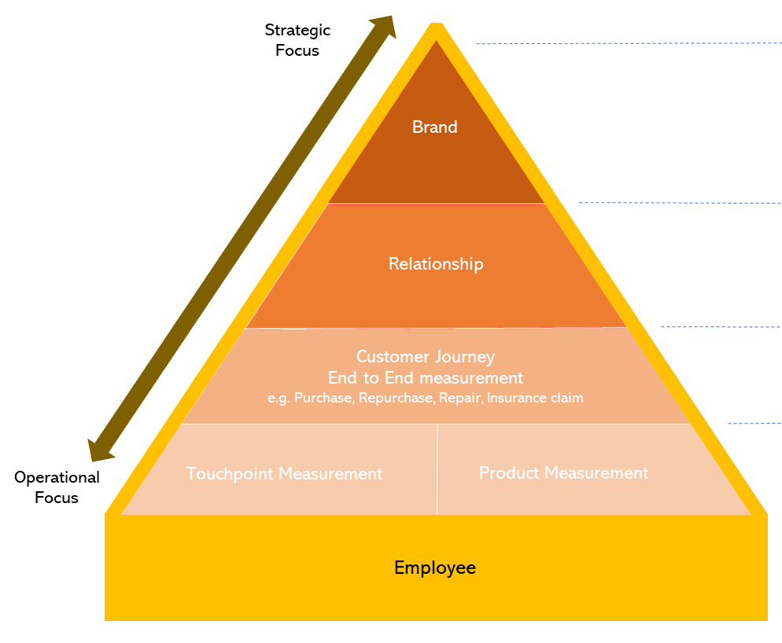
Organizations don’t need more data, they need simplification and integration
Notes:
An Experience intelligence and measurement ecosystem can be the bedrock which holds all the components of Experience together. It provides the critical ability to show how all the parts of Experience work individually, collectively, and drives improved commercial benefit.
Such a system should be able to:
• help identify the parts of the experience that need improving predict the value of improving a particular experience, both in Experience terms (e.g. NPS, satisfaction, customer effort, etc) and financial (revenue, market share, churn, etc)
• quantify the results of the improvement
• capture the context of why changes to Experience have or haven’t worked
• help employees understand the value of their contribution to that improvement
• provide confidence to the C-Suite that the investment delivered benefit, or if not, being able to
explain why not
Opportunity 1: Be clear on the main KPI and elevate this to board-balanced scorecard
Opportunity 2: Measure that main Experience KPI across every part of the ecosystem
Opportunity 3: Use first-party data, where possible, as the source for asking customers about their experience
Opportunity 4: Understanding the context to help identify the right actions
Opportunity 5: The opportunity to unify Brand and Experience

Slide 18
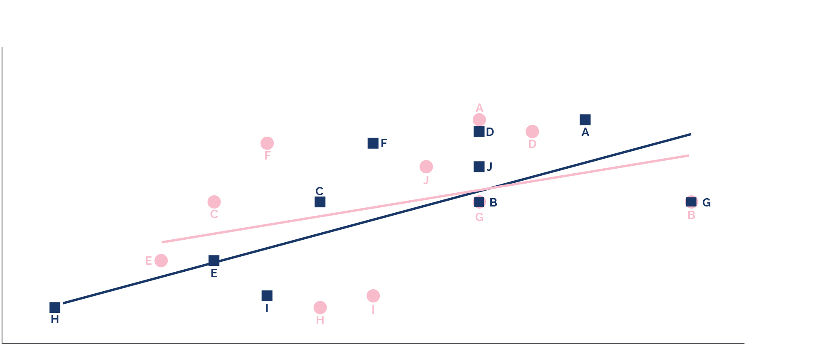


Introducing Excess Share of Experience (eSOE):
a better correlator to Market Share (than eSOV)?
Data demonstrates a much stronger relationship between eSOE and Market Share compared to eSOV
25
20
15
Share of Market
10
5
0
5
7
9
11
13
15
17
19
Share of Voice/Experience %
Comparison of SOE with SOV on correlation with share of market
Source: Mesh: The Importance of Measuring Experience

Slide 19
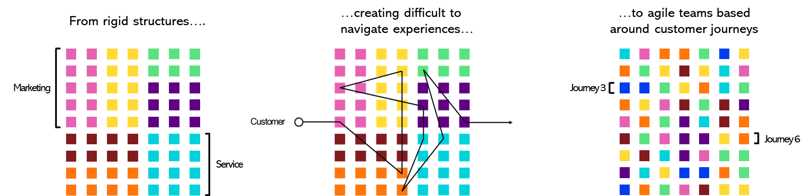
Moving to an Enterprise wide approach to Experience ownership with increased collaboration
Source: Wunderman Thompson
Key:
Marketing
Operations
Finance
Insight
IT
Service
Legal

Slide 20
The formula to increasing Experience value through balancing Brand Friction and Effort
Positive Brand Friction
Frequency of repeat purchase
Customer Effort
Number of customers
Experience Value
The cost of delivering the experience

Slide 21
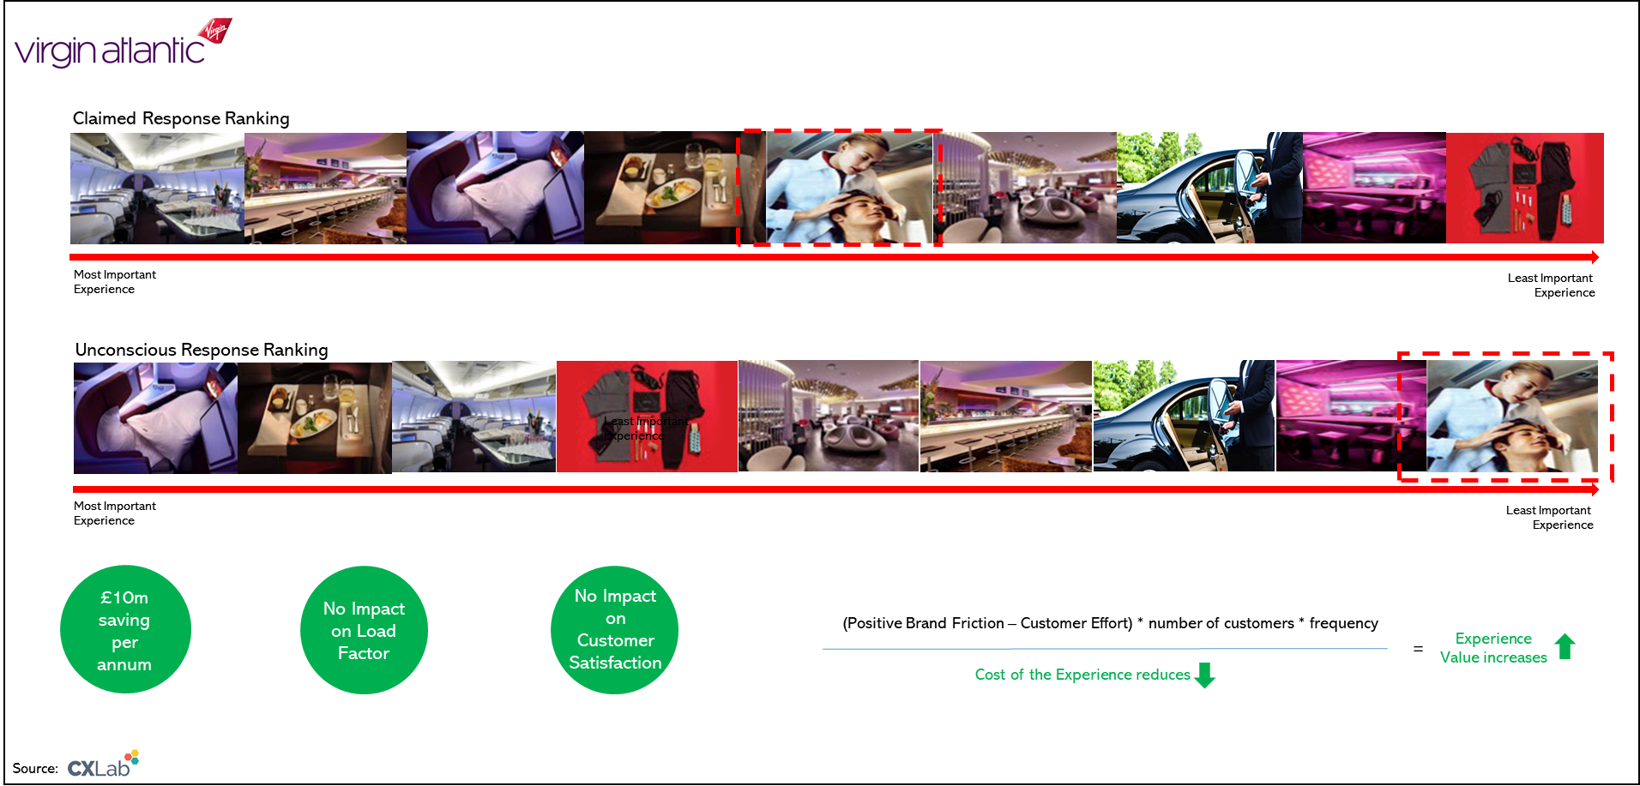

Case study: balancing Brand Friction and Effort by removing non-value add experiences
Positive Brand Friction
Customer Effort
Number of customers
Frequency of repeat purchase
Experience Value
The cost of delivering the experience

Slide 22
Two ways Marketing should have a bigger role as the Experience leader and chief Experience influencer
1
Marketing as the influencer
Start with the elements of the experience that marketing controls to build trust and collaboration.
2
Marketing as the leader
Marketing leading the organisation as it has the vision, the customer and the commercials at its heart.
Notes:
If we have successfully identified that creating positive brand friction without compromising customer effort is key to delivering value through Experience, then it naturally suggests that Marketing should have a bigger role as the Experience leader and chief Experience influencer in organisations.

Slide 23
In Conclusion, three key takeaways
1
The concept of Positive Brand Friction
2
The simplification and integration of data
3
The potential opportunities with excess Share of Experience

