Slide 1
Price for Success
How to build sustainable commercial partnerships
Notes:
Hi,
I'm Dan Forman one of the Global Commercial Leads for WPP. I've spend my career working as a CFO or commercial leader within independent agencies to global holding companies.
Strong longstanding commercial partnerships have always been critical with all my client relationships and when done well grow value for the client and growth for the agency

Slide 2
„
Introduction
Setting the scene
„
Innovation in the way agencies price their services has lagged behind the innovation shown in the products and services they offer.
Marc Nohr, chairman, Commercial Leadership Group, IPA and CEO, Fold7
We often see a clear correlation between the quality of commercial relationships and the role agencies play.
Great commercial relationships provide a sound foundation for growth and success.
Equally, broken commercial relationships can render even exceptional strategic and creative outputs unproductive and ineffective.
„
Vlad Komanicky, Co-founder, Alchemists
Examine any agency and client relationship through this lens, and you should find it a lot easier to develop a robust and objective model which won’t die on its feet. Large sums of money, or otherwise
Dan Forman, member Commercial leadership Group, WPP Global Commercial leader

Slide 3
Price for Success
Key objectives

Slide 4
1
Build on the Price of Success report from 2019 by the IPA, which went into detail behind tools and pricing mechanisms and then to build a framework around this which will help agencies drive long-standing strong commercial relationships.
Notes:
Our aim with this programme is to Build on the Price of Success report from 2019 by the IPA, which went into detail behind tools and pricing mechanisms and then to build a framework around this which will help agencies drive long-standing strong commercial relationships.

Slide 5
2
Show agencies that - while they may not always realise this - they are already well set up to innovate with pricing.
This guide should give them the tools they need to price differently, in a way that is appropriate to their products, services and the current client relationship. As well as the practical advice to do so.
Notes:
There is no longer one size fits all for our agency engagements
We need a way forward and a framework, which allows both agencies and clients to transparently agree, what are the best pricing systems for not only the work, but their relationship
In my experience fee systems often get antiquated as though the type of work and relationship changes, the commercial deal is often left in the background until it’s no longer fit for purpose
Commercial relationships need to evolve over time, at the same speed as the change in the product
Good commercial relationships are proactive to the changing landscapes and work performed between the client and their agency
Agencies have a better set up than they think for this.

Slide 6
3
Destroy the myth that you can only innovate with pricing having established a long-term agency-client relationship.
You can innovate with pricing at any stage. By understanding the elements of risk and reward you able to evaluate your relationship and innovate where appropriate.
Notes:
Agencies need to realise that a long term relationship does not meant they can’t innovate their pricing systems
We can innovate at any stage - even if that’s as rudimentary as leveraging a risk / reward scheme against existing pricing
For me when these innovations are delivered hand in hand with marketing and procurement, the results grow value for the client and growth for the agency
For me this is the sole purpose behind this exercise!
I'll now hand you over to Vlad and Henry who can talk you through what we have done to help this

Slide 7
Price for Success
Introduction to our thinking

Slide 8
Introduction
Team behind this report
Notes:
Thank you, Dan, for a fantastic opening to our presentation and for highlighting the key objectives for this report.
I’d firstly like to introduce myself and Alchemists to all of you. Let me firstly cover why we are the partner for IPA to choose to work with on this report.
I’m Vlad, a co-founder of Alchemists and I’ll introduce you to the strategy behind this report. Also, I’ve brought with me Henry Wisdom, Head of Alchemists Commercial Consultancy who will present our approach in detail.
But let me talk a bit about Alchemists. We are a Marketing advisory, and we work with major blue-chip brands on resolving a variety of issues faced by CMOs, Marketing Directors or Marketing Procurement.
When we founded Alchemists, we had a simple unifying goal in mind; how to genuinely mix the Magic of Creativity with Logic of Commercial World. I come into this with over a decade of experience of working in Marketing and Procurement teams at some of the largest multinationals. I’ve set-up Indirect Procurement at Mars in Central Europe, have managed Global Digital Agency strategy at RBS, and lead Global Agency Procurement teams at Vodafone and GSK.
I have also spent five years in Consultancy and Intermediary world. At Alchemists, we worked with brands such as NIVEA, Blackrock, Invesco or Delta Airlines, solving many of their challenges ranging from building modern agency ecosystems to effective in-housing to benchmarking and creating effective commercial models.
But coming back to Alchemy and blending the right mix of creative and numbers. That’s the approach we’ve taken for this report. We thought about how we can create a process that’s rigid and solid at its foundation. But also practical and adaptable to a myriad of unique situations any of you will find yourself in.
No client or agency is the same. So our solution needs to work for all.
Let me take you through the thinking behind this report.
Thanks Vlad. Hello, im Henry Wisdom, head of commercial consultancy here at Alchemists. Its really fantastic to be speaking today, albetit virtually.
We’re incredibly excited to share our approach with you and the potential ease and clarity this can bring to its users.
At Alchemists I work across an array of projects including migrating existing client/agency relationships from commercial structures that cause tension through their difficulty to handle to structures that are right for them.
I join Alchemists from Intersnack group, where I’ve lead their marketing procurement function across Europe for the last few years after working with organisations like Samsung, McDonalds and large banking institutions previously.
I’ll be explain our approach to you in detail shortly.
Back to you Vlad

Slide 9
The first step to thinking and acting differently towards develop sustainable commercial partnerships, is to start talking differently.
Changing the mindset from finding a specific model to developing fit-for-purpose commercial partnerships.
<< Rigidness
>> Agility
Notes:
Firstly, we need to get our mindset right. Today’s world is all about Agility, and being Rigid in any approach you take does seldom lead to achieving desired outcomes. In our view Agility means adaptability, and that is what makes a difference between succeeding consistently; or not.
We want you to stop thinking about models and choosing the one that will resolve all your challenges. That simply won’t work. We want to encourage you to change your mindset. From these rigid models to building flexible partnerships.
We’ll provide you with a guide to take you through some of the very first steps of that journey.

Slide 10
Just because your commercial partnership works, that shouldn’t stop you from exploring how you could make it even better.
Innovation needs to come with a purpose and thought and needs to be built on the right foundations.
<< Status Quo
>> Thoughtful Innovation
Notes:
One of the key objectives - that you’ve already heard about – is to encourage you to innovate when you have the right foundations in place. We talk about thoughtful innovation. That means innovating when it makes sense – and avoiding potential pitfalls of just trying to go too fast.
But when that foundation exists, you should have no excuse of just accepting the status quo. We talk about agencies gaining some of the lost ground as strategic partners to businesses. We don’t think you can get there unless your you make your remuneration more aligned to your clients’ success.
You need to be in it together. As we often say – in good and in bad.

Slide 11
We do not need to reinvent the wheel. There’s no need for complexity as some fundamentals don’t need to change if they’re right.
Simplicity is often achieved by keeping what works and changing what doesn’t, and this is the approach we’ve taken.
<< Complexity
>> Simplicity
Notes:
We’ve seen too many attempts at a transformation that are just plainly unsuccessful, just because people try to reinvent the wheel completely. We’re all up for a bit of shake-up in anything we do, but we also know, when it’s best to conserve energy.
And believe us, you’ll need it. Any change management journey is often more tiring than what we’d like it to be. Keep what works, reinvent what doesn’t.
Keep it simple. But not simplistic.

Slide 12
Fundamental factors of pricing remain but current models must adapt.
The eight key components of Commercial Partnerships
Time & Materials
Output
Results
Retained
team
Creative
service
menu
Business
performance
Project
team
Production
menu
Value /
equity
Licensing/
subscription
Commission
Notes:
Let’s talk about how we achieved this simplicity and where we’ve kept what we think works. And where we’ve innovated and updated the past approach.
I believe we’d all agree that the three fundamentals of how you can price, do not need to be changed—you either price by Time, by Outputs or based on Results.
What we believed needed a bit of a refresh were the key commercial components. Yes, components, not models; As you should combine these into the right blend. Just the right one to form the basis of successful commercial partnerships with your clients.
You can read about each of these in full in the report. We also provide clear guidance to key watch-outs, pros and cons as well as when these component are best used..

Slide 13
Client need
Your offering
Value attribution
Commercial capabilities
Relationship
Risk
Notes:
Another area that we felt didn’t need to be changed were the six pricing factors. These are the right areas to consider when you’re structuring your commercial relationships.
However, we have, in some cases, significantly revised what they are and how you should evaluate each factor. Let me just quickly take you through a quick summary of each factor.

Slide 14
Client need

Slide 15
Client need
Your offering

Slide 16
Client need
Your offering
Value attribution

Slide 17
Client need
Your offering
Value attribution
Commercial capabilities

Slide 18
Client need
Your offering
Value attribution
Commercial capabilities
Relationship

Slide 19
Client need
Your offering
Value attribution
Commercial capabilities
Relationship
Risk

Slide 20
Client need
Your offering
Value attribution
Commercial capabilities
Relationship
Risk

Slide 21
Price for success
At a glance

Slide 22
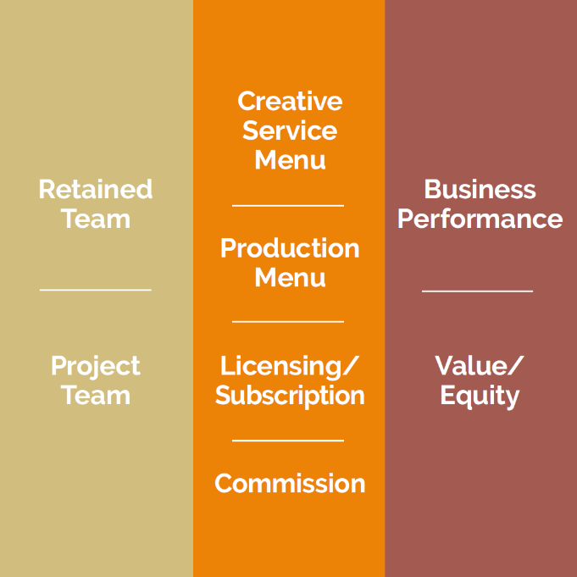
The key steps to create your agency’s commercial score
Client need
Your offering
Commercial capabilities
Relationship
Value attribution
Risk
Baseline
score
Relationship
and risk factors
Choosing the right components
Notes:
This may look heavy. But once familiar, its an incredibly simple process to follow. significant rigor, but a simple one. When familiar with it, 5 minutes at the start of a pitch response meeting or 5 minutes with your new biz team and financial lead can do a lot to focus your approach and craft your approach .
Compare it to agency evaluation sheet that clients might use when assessing a pitch, ‘bias and blindspots’
We map the the client need vs the client offeing together, followed by the value attribution vs commercial capabilities. How well can the value of your services be measured, reported and evaluated against joint commercial capabilities.
Baseline (foundation) x relationship and risk factors = reality
Relationship &r risk
By Factors we mean multipliers. Selecting the maturity of relationship and the risk you are willing or able to make on this account or assignment.
Commercial score
Through this process we produce a holistic assessment of readiness to implement.
A framework so agencies - and clients - can see which models are best suited for the engagement.
The higher your score, the more likely you are to implement the more complicated components successfully.
Those were to provide you with a guide to help you understand when you are ready (and should) innovate within the commercial relationship, but also make you aware of the risks of implementing components that are too complicated.

Slide 23
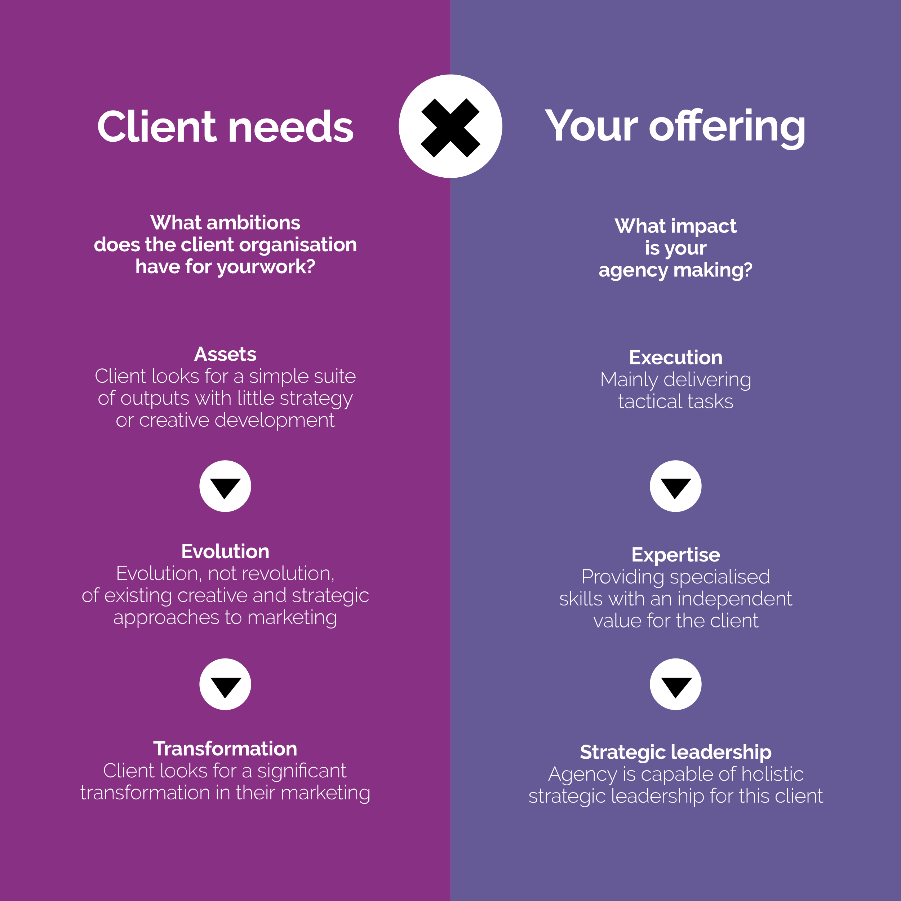
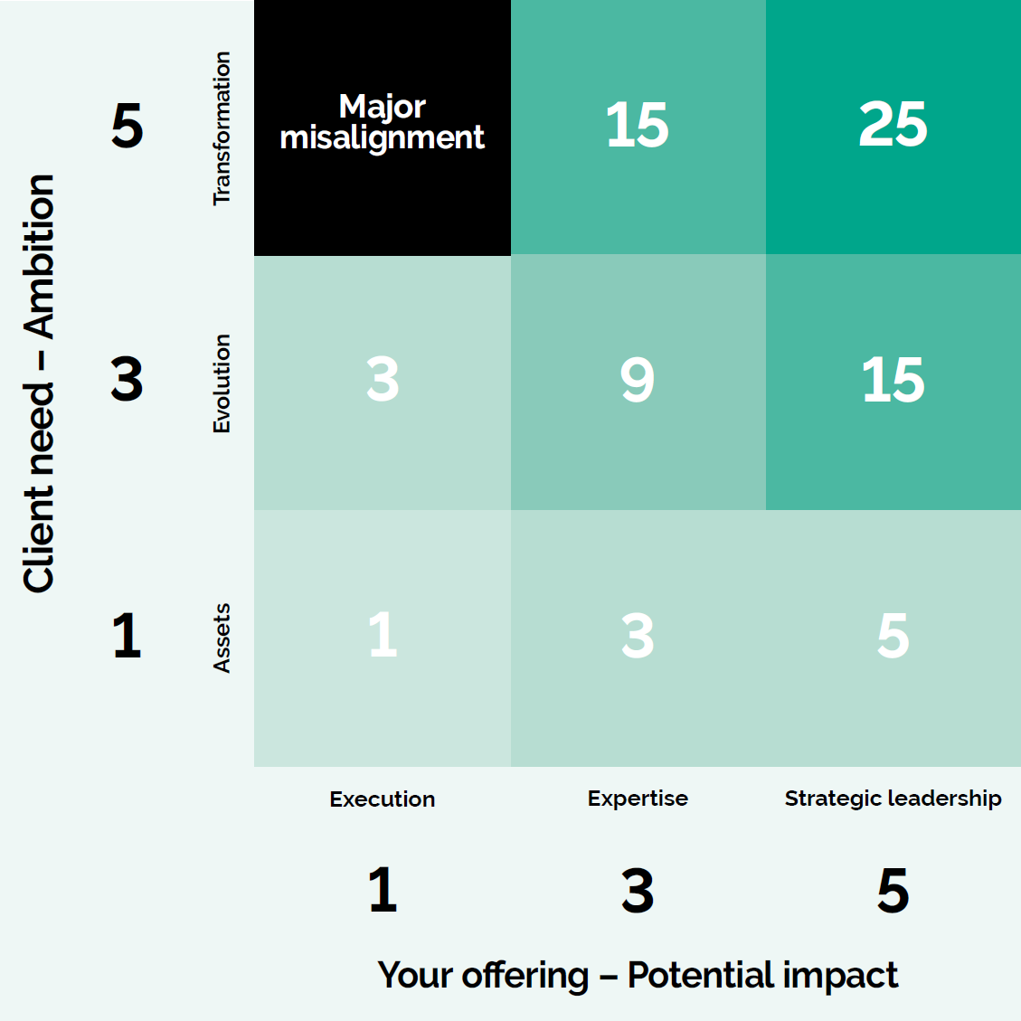
Baseline score – Client needs x Your offering
Notes:
Correlation between these two areas; how does ambition meet with your ability to make an impact?
What ambitions does the client organisation have for your work with them? Assets, evolution, transformation.
What impact is your agency making – execution, expertise or strategic leadership
Lets say we’re a CRM agency for a brand with a pre existing creative platform and array of assets but we’re we’re working with the client to significantly uplift their strategy and performance in that discipline.
Client need on the left and offering on the right
Score of 9. remember this and carry it over
Major misalignment – If the client is asking for transformation but giving them execution something is very very wrong
In the first phase of the scoring process, we want to assess the potential impact an agency’s work can have on its client. You’ll need to understand and assess both the client need and where your agency’s products and services are postioned. This is the most critical assessment in the process as it forms a crucial role in this evaluation and has the highest impact on the total Commercial Score.
Next we ask you to assess how well the client can attribute its marketing activity to business performance as well as the combined commercial capabilities of agency and client.
Together, all these factors explain the quality of the foundations for a future commercial partnership.

Slide 24
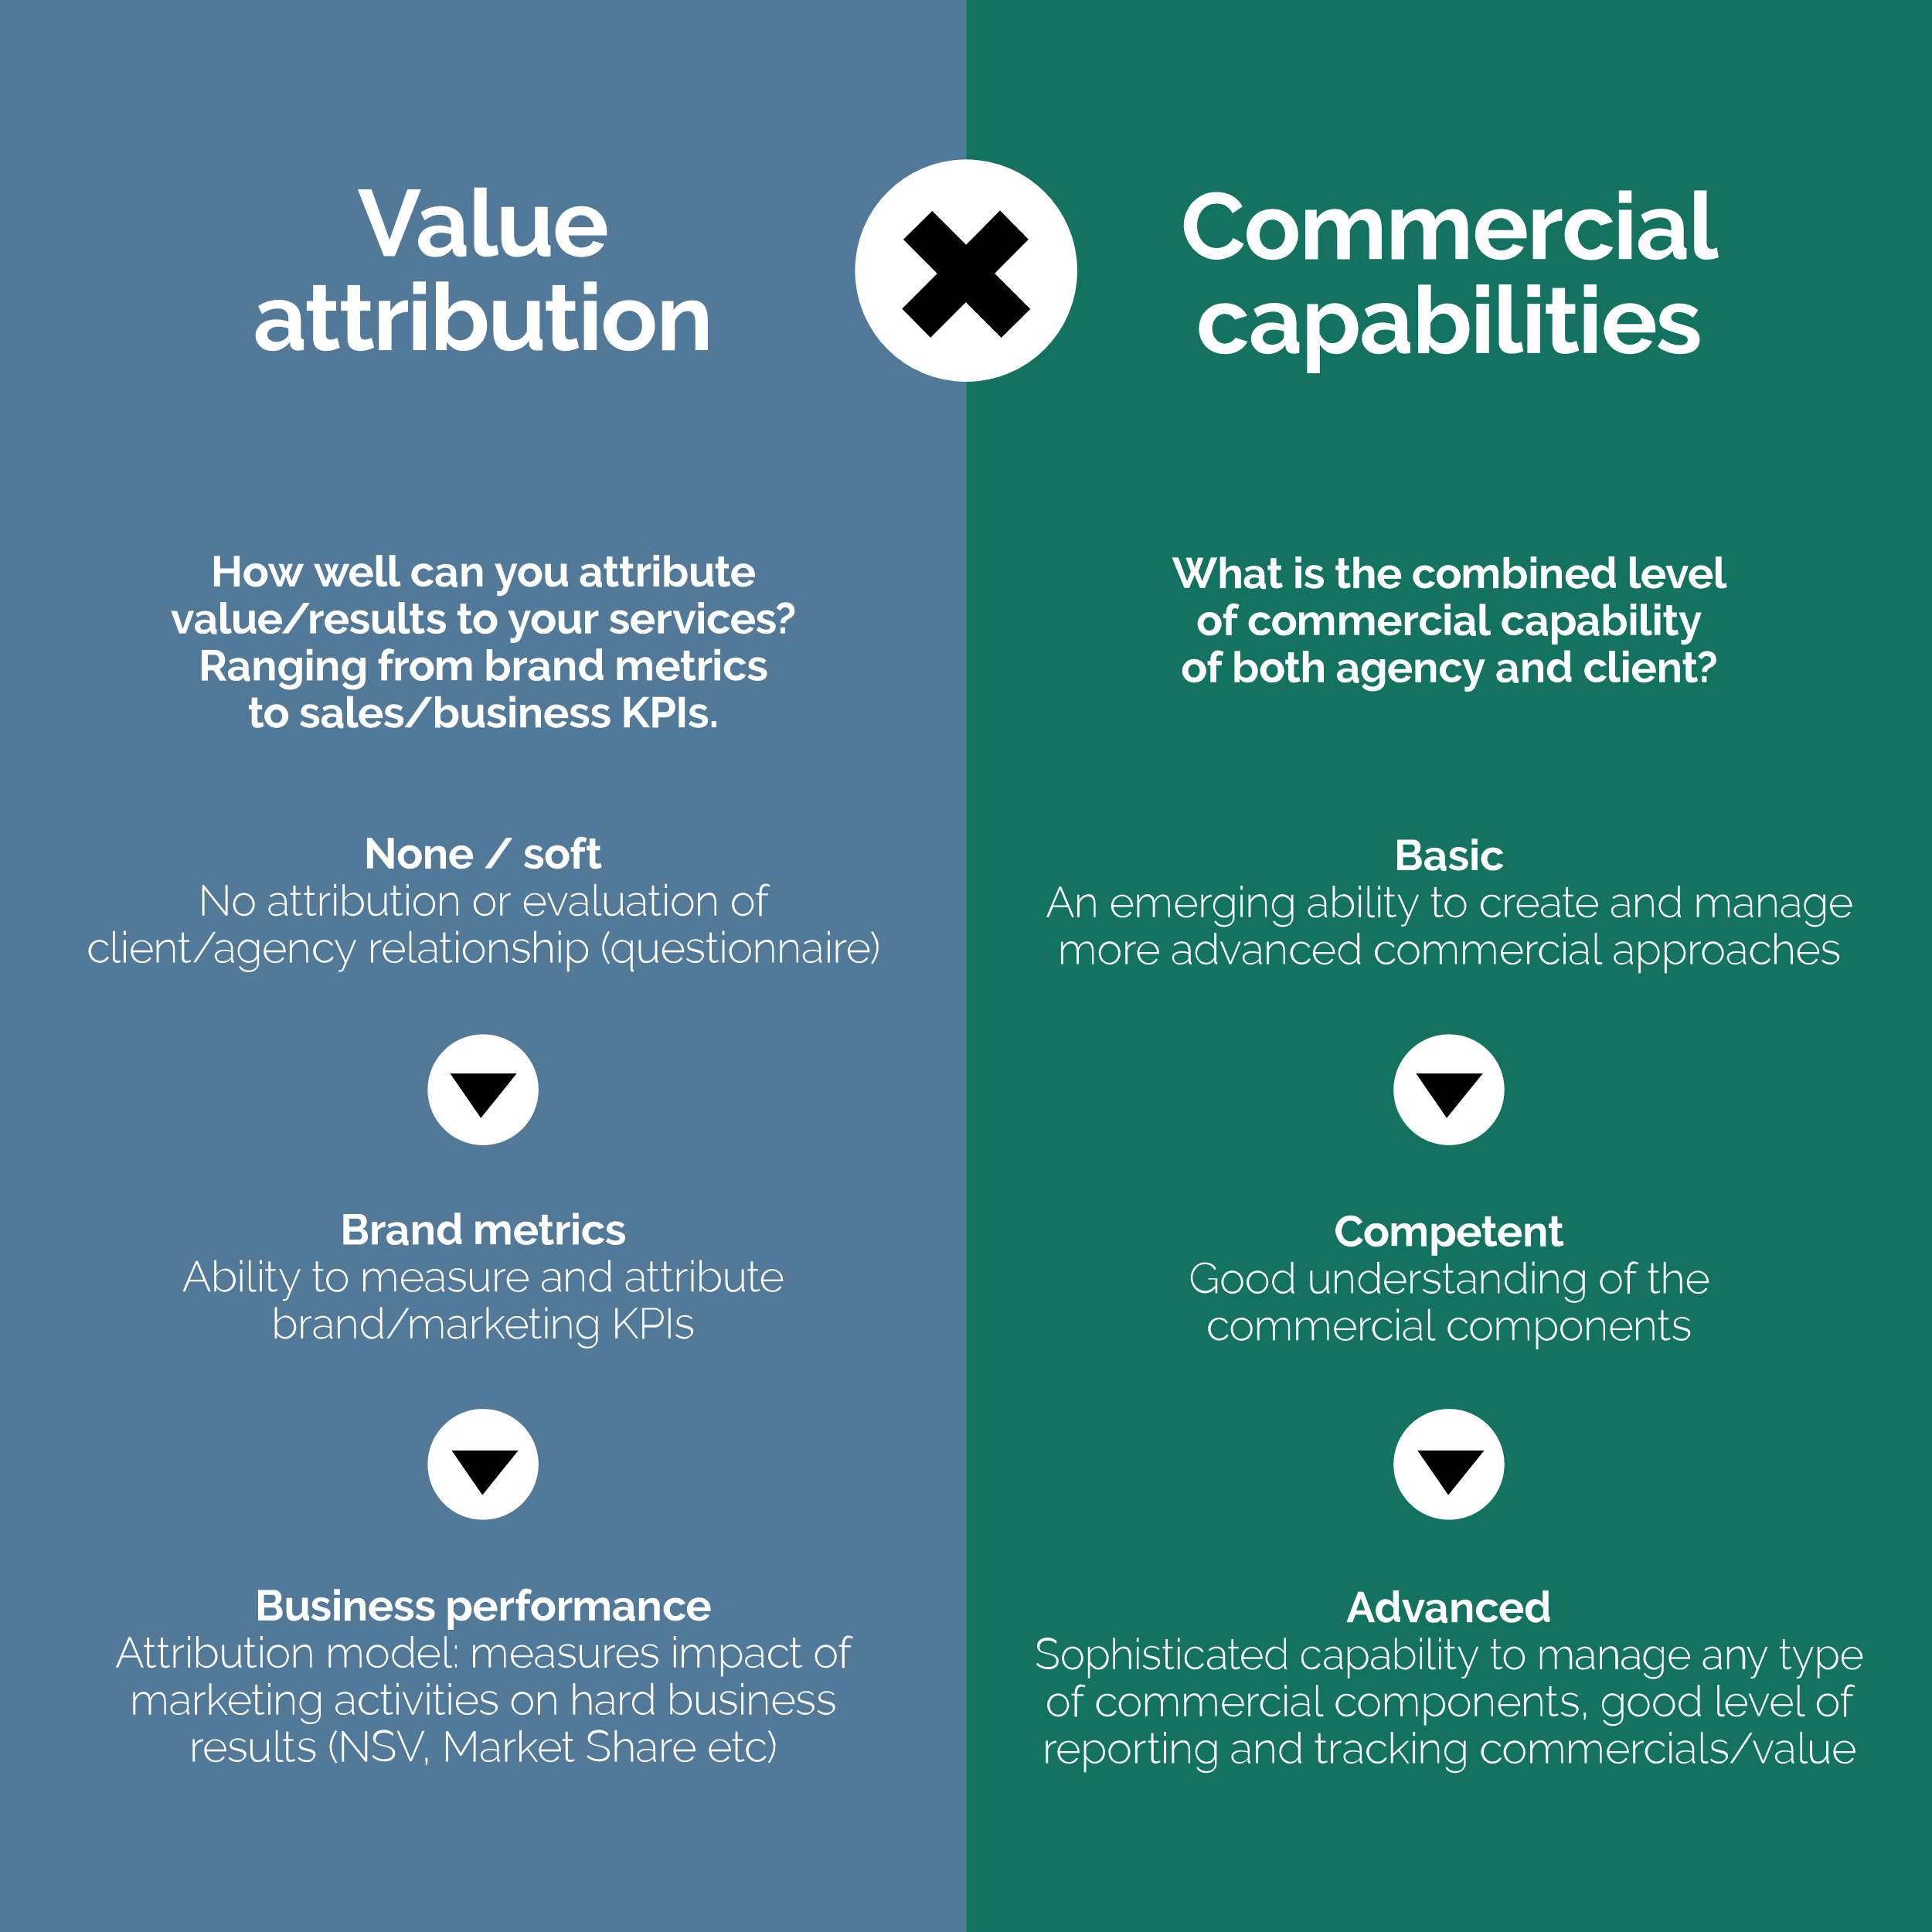
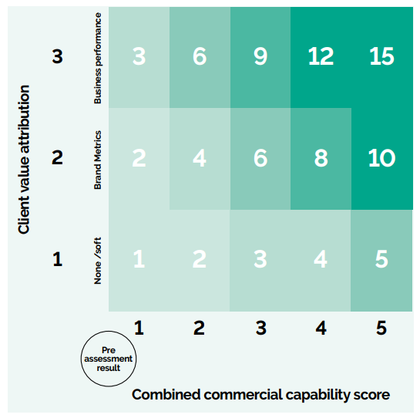
Baseline score – Value attribution x Commercial capabilities
Notes:
we ask you to assess how well client can attribute its marketing activity to business performance as well as the combined commercial capabilities of agency and client. Simplify value attribution – simply asks you to reflect on the level of attribution available. Client or nature of product/service.
Brand - brand salience, likelyhoood to buy
BP – net sales value & market share
Commercial capabilities of agencies and client – there is an additional step within the document to help you hone this in.
Commercial capabilities – between you and the client what is your combined commercial ability
Reflect on the sophistication of the client's finance function, marketing's influence over budget and the maturity of its marketing procurement functions.
Agency you will need to consider the sophistication of your internal capability to manage commercial relationships and your abilities in management information and reporting. Be honest with
In the first phase of the scoring process, we want to assess the potential impact an agency’s work can have on its client. You’ll need to understand and assess both the client need and where your agency’s products and services are postioned. This is the most critical assessment in the process as it forms a crucial role in this evaluation and has the highest impact on the total Commercial Score.
Next we ask you to assess how well the client can attribute its marketing activity to business performance as well as the combined commercial capabilities of agency and client.
Together, all these factors explain the quality of the foundations for a future commercial partnership.

Slide 25
Baseline score & relationship and risk factors
35+
Exceptional
18-34
Strong
10-17
Intermediate
6-9
Emerging
<5
Basic
Notes:
Max score of 40 through this stage adding those two previous steps together.
To give you a feel of each level
35+ - highly strategic relationship with a well established client. Encourage maximum innovation
10 – 17 – A relationship with strong potential for growth and encouraged to explore some innovative commercial strategices
5 – Basic – Do not add any complexity at all. Build your relationship on simplicity
The next two factors help us to move from the theoretical and more practical with the reality of the relationship and the overall approach to risk.
Relationship multiplier
We believe there are 4 main phases to an agency client relationship
Transaction
Foundation
Belief
Trust
We outline how to recognise the stage of your relationship within the report but on a high level
Transaction - When you are building an initial proposal with a new client, in initial negotiations or in the early days of a new relationship.
Foundation –experienced how the other organisation works and a joint vision has been established. Teams work well together but with an “us” and “them” dynamic.
Belief – Both parties understand the pace they want to operate at and the expectations of the work. The partnership is fuelled by insights and customer behaviours. The team is recognised as building innovative solutions for the client.
Trust – “We are in it together”: a full sense of partnership and mentality with permission to challenge the status quo. An understanding of the impact creative has on business results.
The pinnacle of any client-agency relationship. It is when we see genuine collaboration of honest, trusted partners with an almost unbreakable team bond. It is where there is total belief for each other’s capabilities – where every part of the agency-client cog works in sync and where both sides feel supported and valued.
RISK
reality of both the relationship and your overall affinity for risk.
High risk – coming out of a pitch, excited about the future, trusted relationship which allows for entrepreneurial approach
Normal – skin in the game for equal and proporitionate returns
None – concerns – particularly commercial ones. Keep things simple and straightforward

Slide 26
Calculating your score
How it all adds up
The commercial score is calculated by multiplication of the baseline score by each factor. The result can be a number between 1 and 120.
We consider any score above 60 to be exceptional as it requires a very solid baseline, as well as conscious acceptance of some risk. Any score above 40 is considered to be sufficient to explore almost any commercial component.
Baseline
score
Relationship
and risk factors
Commercial
score
35+
Exceptional
60+
Exceptional
18-34
Strong
2.0
Trust
1.5
High
40-59
Strong
10-17
Intermediate
1.5
Belief
1.0
Normal
20-39
Intermediate
6-9
Emerging
1.25
Foundation
0.75
Low
11-19
Emerging
<5
Basic
1.0
Transaction
0.5
None
<10
Basic
Notes:
Let me recap.

Slide 27
What your commercial score means
Value/
equity
60+
Exceptional
Business
performance
The higher your score, the more likely you are to implement the more complicated components successfully.
Your score should act as a guide to help you understand when you should innovate within the commercial relationship, but also make you aware of the risk in implementing components that are beyond the abilities of the relationship.
Creative
service
menu
40-59
Strong
Production menu
20-39
Intermediate
Project
team
Licensing/
subscription
11-19
Emerging
Key
Retained
team
Commission
<10
Basic
Time & Materials
Output
Results
Notes:
A score of below 10 we would encourage stay as simple as possible.
Any score above 60 means we would encourage you to innovate.
As the socre increases through the ranges you unlock these commercial components.
For example a score of 20 would suggest
Retained
Commision
Project team
Licencing
And the very cusp of production menu
Pre requisits in are in the document which can help you further recognise whether these are right for your relationship.
If you are attempting components more complicatesd than your score indicated we would advise caution. They may in some instances be easy to set up, but challenging to manage or vica versa.
We would encourage you read the report and try this for yourself on an existing or potential new client relationship and may help to focus on commercial components righjt for the relationship
We have stress tested rigorously and lookm forward to your thoughts and experiences of using the tool with all the nuances and differences of your client base.
Back to vlad

Slide 28
Practical information available in the whitepaper
It’s not just about the score
We have provided much more detailed and practical information and Q&As in the full paper. We will explore these additional areas and topics:
1.
2.
3.
4.
Output model / Creative service menu
How to implement this component
The dilemma of time-sheets
Elastic delivery expectations vs defined deliverables
How /if to implement without adequate data on outputs
Performance-based fees
How to implement any performance fees when the client doesn’t invest adequate time
How to deal with varied levels of complexity based on the types of KPIs (hard to soft)
Pricing in practice
Working / Non-working media ratios – how to address those
Pricing in pitch process
Measuring profitability across varied commercial partnerships
Global FMCG client case study
Model in practice – how it was applied to a live project
Evolution across 3 years of relationship
Example of the components used
Notes:
Thank you, Henry, for taking us through the process. I hope even if it might seem a little bit daunting at first sight, it is not that difficult to use in real life.
We are also going beyond just this process in the Price for success report. There are more practical examples, exploring many interesting topics.
We’ll cover many questions focused on exploring how to implement Creative service menu or Performance-based fees. We’re also exploring additional, often quite hot topics, such as WM rations, Pricing in pitch or measuring profitability.
And lastly, we promised, that this is a practical process. And we will show you how to use this in practice in an example case study of one of our global clients. Let me give you a glimpse to what you can find in this case study.

Slide 29
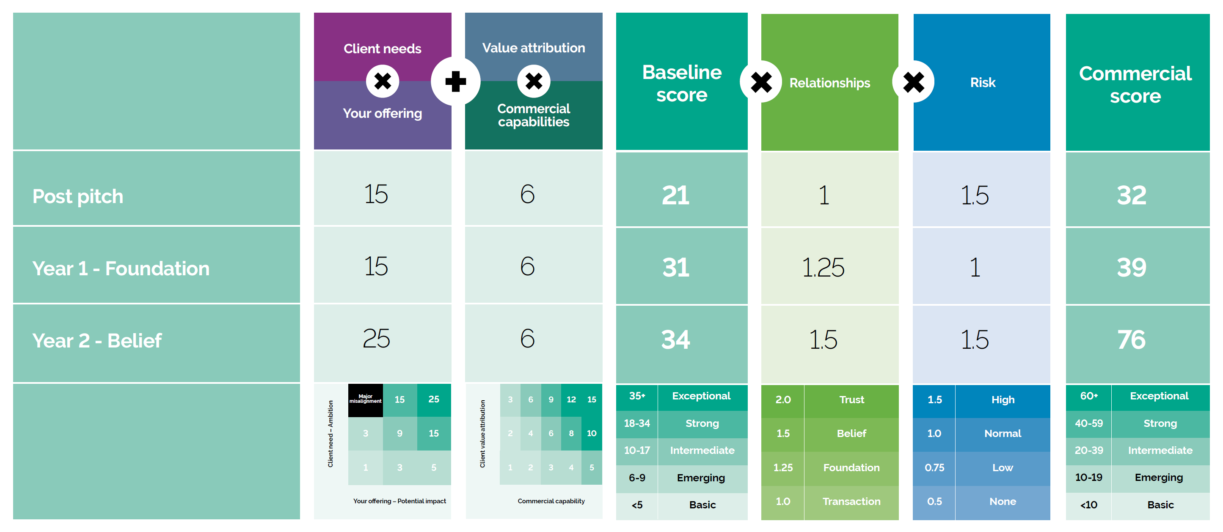
Alchemists Case Study
Approach in practice
Notes:
We’ll explore the evolution of Client-agency relationship, from the pitch phase over the next two years. We show how to utilise our process as well as how we’ve evolved the commercial partnership.

Slide 30
Price for Success white paper
Available to download from the IPA website.
Summary
How to find out more
Workshops
Joint workshops run by the IPA & Alchemists will be available from January 2021.
Get in touch to find out more.
Notes:
This takes us to the end of our presentation. I hope that we have intrigued your interested. And that you’ll visit the IPA website and download (and read!) the entire report. We’ll leave you to be the judges of whether we have achieved the objectives we set out at the start.
I hope that we’ll contribute with this initiative to the change in the way how you – agency leaders – look a the commercial partnerships. I believe that no relationship can become genuinely strategic in this complex, and often yet, not fully understood world; unless you base it on a foundation of credibility, trust and capability. Then you’re set-up for success.
And we’ll be here if you would appreciate a bit of help or independent assessment and guidance on this journey.
Thank you so much for spending the last 30 minutes with us. We genuinely hope you have found those to be a good investment of your valuable time.
Let’s keep this discussion going.

Slide 31
Thank You

Slide 32
How to price for success
The process for building partnerships
Understand the pace and approach of how to structure your commercial partnerships and you will be able to price for success.
We refer to six pricing factors in our research.
Let us take you through these factors and explain how we use them.

