Slide 1
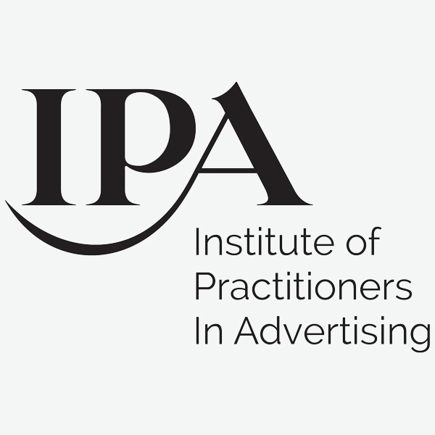
A new 2030 vision for:
The Future of
Brand & Agency Relationships
Meabh Quoirin
Co-Owner & CEO
Josh McBain
Consultancy Director
–
IPA Business Growth Conference
November 2020

Slide 2
The Future of Brand & Agency Relationships
IPA Business Growth Conference
1. Consumer Landscape in Flux: Navigating consumer futures in the 2020s | 2. Industry Futures: Forces shaping the future of advertising | 3. Future Brand-Agency Relationships: A pendulum of working models

Slide 3
PART 1: Consumer Landscape in Flux
The Future of Brand & Agency Relationships
IPA Business Growth Conference

Slide 4
Impact of COVID-19
The Future of Brand & Agency Relationships
IPA Business Growth Conference
How to read this map…
The visualisation on the left-hand side of the slide demonstrates which trends have been impacted by the COVID-19 pandemic and how – as well as whether we believe this impact will be temporary or sustained.
Sustained
impact
Presence Free Living
Building Resilience
All
Inclusive
Shoppable
Universe
Game
On
Content A La Carte
Mechanised
Truth
Neo-
Civility
Paused/de-prioritized by COVID-19
Choice Partners
The Me Me
World
Meta
Messaging
Latchkey Loyalty
The Influencer Age
Customized
Reality
Energized by
COVID-19
Cool to be Kind
Data as
Currency
Audiophilia
360
Rewards
Human
Encounters
Temporary
impact

Slide 5
The Key Five: Macro Consumer Drivers
The Future of Brand & Agency Relationships
IPA Business Growth Conference
1. Consumer Centricity | 2. Healthy Data Relationship | 3. Empathetic Brands | 4. Radical Transparency | 5. Brand Partners

Slide 6
Consumer Centricity: Ubiquitous brand presence across all consumer channels
The Future of Brand & Agency Relationships
IPA Business Growth Conference
% who buy a product/service online at least weekly | June 2020
Source: Foresight Factory | Base: 1079 online respondents aged 16+, GB, 2020 June

Slide 7
Consumer Centricity: Ubiquitous brand presence across all consumer channels
The Future of Brand & Agency Relationships
IPA Business Growth Conference
46%
of 16-24s have played online & computer games more since COVID-19

Slide 8
Healthy Data Relationship: Evaluating the value of personal data and incentives
The Future of Brand & Agency Relationships
IPA Business Growth Conference
“I am happy for my healthcare data to be used in medical research” | June 2020
54%
AGREE
16%
DISAGREE
All of [these measures] must be temporary, necessary, and proportionate. When the pandemic is over, such extraordinary measures must be put to an end and held to account.
Privacy International
Source: Foresight Factory | Base: 1079 online respondents aged 16+, GB, 2020 June

Slide 9
Empathetic Brand: Companies increasingly fulfil a key role in society at large
The Future of Brand & Agency Relationships
IPA Business Growth Conference
Cool to be kind in 2020
Source: Edelman Trust Barometer, 2020.

Slide 10
Empathetic Brand: Companies increasingly fulfil a key role in society at large
The Future of Brand & Agency Relationships
IPA Business Growth Conference
"The media industry in this country is not doing a good job at representing diversity in TV programmes, films etc."
31% AGREE
VS.
27% DISAGREE
Netflix funds Black creators – streaming giant gives $5 million to support and promote diversity.
Source: Foresight Factory | Base: 4085 online respondents aged 16+, GB, 2019 May

Slide 11
Radical Transparency: New avenues to transparent marketing communications
The Future of Brand & Agency Relationships
IPA Business Growth Conference
Need to have a better way of evaluating the quality of products and services bought | % selecting strong or moderate need | June 2020
Source: Foresight Factory | Base: 1079 online respondents aged 16+, GB, 2020 June

Slide 12
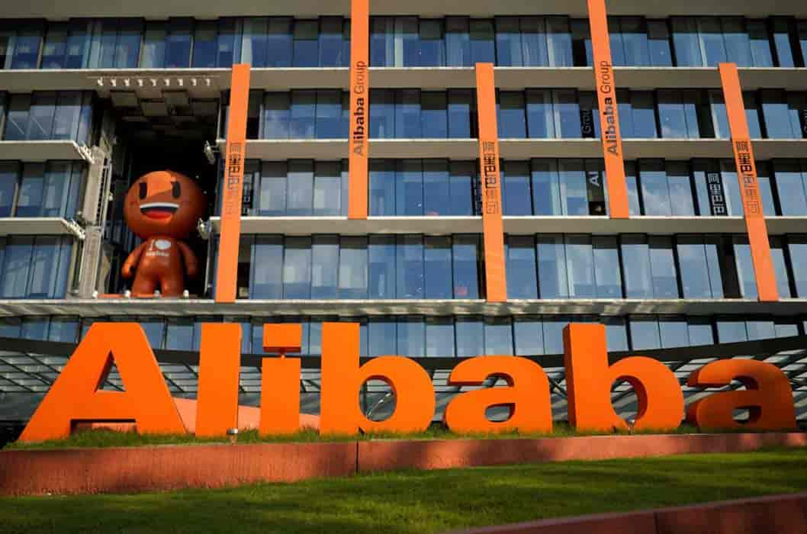
Brand Partners: Companies become trusted companions for consumers
The Future of Brand & Agency Relationships
IPA Business Growth Conference
Belief companies are as responsible as government to help people during the coronavirus | June 2020
60% AGREE
VS.
21% DISAGREE
Source: Foresight Factory | Base: 1079 online respondents aged 16+, GB, 2020 June

Slide 13
PART 2: Industry Futures
The Future of Brand & Agency Relationships
IPA Business Growth Conference

Slide 14
The Future of Brand & Agency Relationships
IPA Business Growth Conference
Nigel Vaz, CEO of Publicis Sapient
Lindsay Pattison, Chief Client Officer at WPP
Laurent Ezekiel, Chief Marketing & Growth Officer at WPP
Dan Clays, CEO of the Omnicom Media Group (UK)
Mark Lund, CEO of McCann Worldgroup (UK)
Euan Jarvie, CEO UK & Ireland at Dentsu Aegis
Jess Greenwood, Global CMO at R/GA
Rob Bullough, Global Marketing Director at EA
Neil Dillon, Marketing Director at LCY Airport
Gerd Leonhard, Futurist and CEO of The Futures Agency
Jim Moser, Chairman of BBDO Europe
Helen Normoyle, Marketing Director, Boots
Cheryl Calverley, CEO of Eve Sleep
Marc Nohr, Chairman at Fold7
Tim Pearson, CEO at OMD Group UK
Matt Goff, CEO at Adam&Eve DDB
Carly Hunt, Head Of Brand at PANDORA
Jason Cobbold, CEO at BMB London

Slide 15
Overarching Pillars: Future of Marketing Operations
The Future of Brand & Agency Relationships
IPA Business Growth Conference
DATA
(Enabler)
TECHNOLOGY
(Amplifier)
CREATIVITY
(Differentiator)
Access to the vast amounts of new data produced by increased and faster information flows due to 5G, combined with new types of data becoming available (e.g. biometrics).
Use of new platforms and software to analysis the vast amount of data available and convert into actionable intelligence (e.g. AI, Quantum Computing).
Role of human talent and skills to transform the actionable intelligence produced into effective marketing via emotional engagement, creativity and story-telling.

Slide 16
The search for holistic consumer understanding
The Future of Brand & Agency Relationships
IPA Business Growth Conference
The advertising-tech and marketing-tech world and infrastructure will only accelerate, as this loop of getting customer data and
building technology starts to get tighter and tighter… you will get a holistic view of the customer.
The future role of the agency will be to support the marketing team to know not just exactly who our current customer is, but who our potential customer is, and then working to reach those people with the clearest possible message we can.
Nigel Vaz,
CEO, Publicis Sapient
Robert Bullough,
Global Marketing Director, EA

Slide 17
The age of Multi-Dimensional Marketing
The Future of Brand & Agency Relationships
IPA Business Growth Conference
At the moment we are repositioning a 240,000 person company that's about to go through a massive corporate change and for that company 30% of their shares are owned by employees so this new brand isn't just to announce to the market and customers what they're doing differently, it is to explain to their employees not to get spooked, panic, sell or leave. So it becomes a sort of operating principle for way more than advertising.
Jess Greenwood,
Global CMO
at R/GA

Slide 18
An Engineer vs Tool (Strategy vs. Execution)
The Future of Brand & Agency Relationships
IPA Business Growth Conference
Corporations have become so big and complex that organising chaos is a huge part of the agency role. That's a strategic discipline so I think my general view is that the strategic, the Swiss Army Knife strategic agency [is where we will see future growth].
I want an agency that is not like a Swiss Army agency. The agency who have a very, very sharp weapon which does one thing extraordinarily well all day long.”
Robert Bullough,
Global Marketing Director, EA
Jess Greenwood,
Global CMO at R/GA

Slide 19
Searching for a long-term growth partner?
The Future of Brand & Agency Relationships
IPA Business Growth Conference
I would not accept the shared
growth approach from any
agency. I want results. I need
results, otherwise I'm not going
to invest, it's as simple as that.
Neil Dillon, Marketing Director, London City Airport

Slide 20
PART 3: Future Brand & Agency Relationships
The Future of Brand & Agency Relationships
IPA Business Growth Conference

Slide 21
Pendulum of working models
The Future of Brand & Agency Relationships
IPA Business Growth Conference
Titan
Model
Engineer
Model
Coalition
Model
Hybrid
Model
In-house
Model
Single Agency
Single Agency
Multiple Agency
Multiple Agency In-house
In-house
Strategy
Single Agency
Multiple Agency
Multiple Agency
Multiple Agency In-house
In-house
Execution
Partner
Vendor
Engineer
Tool
Longer-term Relationship
Shorter-term Relationship
Hard KPIs
Soft KPIs

Slide 22
Model 1: The Titan Model
The Future of Brand & Agency Relationships
IPA Business Growth Conference
A model in which a brand selects one single external body to provide all marketing services across both strategy development and the execution of all advertising operations.
In this model, the agency acts as a Titan – able to meet all the clients needs across data, technological and creative competencies.

Slide 23
Model 1: The Titan Model
The Future of Brand & Agency Relationships
IPA Business Growth Conference
STRENGTHS Ability to create a framework for consumer understanding that sits centralised in one external body. Synergy between day-to-day marketing operations and macro brand objectives. | WEAKNESSES Risk of groupthink and a lack of specialisation in the execution of the marketing operations. Danger of relationship fatigue.
RELATIVE GROWTH POTENTIAL: MODERATE

Slide 24
Model 2: The Engineer Model
The Future of Brand & Agency Relationships
IPA Business Growth Conference
In this model the overarching marketing strategy is developed by a single external body, the engineer, while the execution of the strategy is undertaken by a multitude of agencies.

Slide 25
Model 2: The Engineer Model
The Future of Brand & Agency Relationships
IPA Business Growth Conference
STRENGTHS Allows customer insights and wider business data to be integrated in one place, but also promotes access to the best talent and capabilities available. | WEAKNESSES Lack of alignment across the multitude of agencies who execute the marketing strategy.
RELATIVE GROWTH POTENTIAL: SIGNIFICANT

Slide 26
Model 3: The Coalition Model
The Future of Brand & Agency Relationships
IPA Business Growth Conference
In this model, the overarching marketing strategy of a brand and the execution of the strategy, is developed and deployed by a coalition of multiple agencies.

Slide 27
Model 3: The Coalition Model
The Future of Brand & Agency Relationships
IPA Business Growth Conference
STRENGTHS Access to a myriad of talent and forms of strategic thinking. Avoids siloed thinking between one agency and the client. | WEAKNESSES Difficult to apply consistently, due to the changing variables of the individual people involved. Success largely dependent on human factors, i.e. personalities in the room.
RELATIVE GROWTH POTENTIAL: LOW

Slide 28
Model 4: The Hybrid Model
The Future of Brand & Agency Relationships
IPA Business Growth Conference
Model in which a combination of in-house client services and external agency services are utilised for both the development and execution of the marketing strategy.

Slide 29
Model 4: The Hybrid Model
The Future of Brand & Agency Relationships
IPA Business Growth Conference
STRENGTHS Optimisation through the pooling of strengths across in-house client services and outsourced agency expertise. Marketing strategy closely connected to macro business objectives. | WEAKNESSES Lack of centralised vision, leadership and measurement across the range of brand and agency stakeholders involved.
RELATIVE GROWTH POTENTIAL: SIGNIFICANT

Slide 30
Model 5: The In-House Model
The Future of Brand & Agency Relationships
IPA Business Growth Conference
In this model, the vast majority of a brands marketing activities are moved in-house; operated by the brand itself.

Slide 31
Model 5: The In-House Model
The Future of Brand & Agency Relationships
IPA Business Growth Conference
STRENGTHS Brand marketing is closely aligned to overall business strategy, alongside reducing overall marketing budgets. Greater agility to move from business need to ideation and marketing outputs. | WEAKNESSES Brands unable to match agency capabilities across all three pillars of marketing operations. Removes injection of new ideas and energy into overall marketing effort.
RELATIVE GROWTH POTENTIAL: MODERATE

Slide 32
In summary: Five Key Takeaways
The Future of Brand & Agency Relationships
IPA Business Growth Conference
1. Consumers are in a state of flux | 2. Consensus on challenges facing industry | 3. Polarisation in role of agency to meet such challenges | 4. Core focus needed on operational clarity | 5. As well as working model agility in the 2020s

Slide 33
A new 2030 vision for:
The Future of
Brand & Agency Relationships
Meabh Quoirin
Co-Owner & CEO
Josh McBain
Consultancy Director
–
IPA Business Growth Conference
November 2020

