Slide 1
Setting the context: where are we?
Stephanie Flanders
Head of Bloomberg Economics

Slide 2
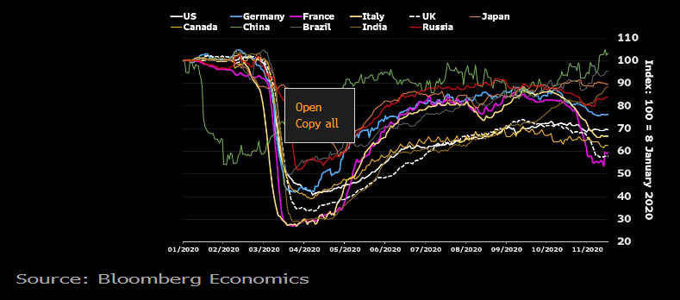
The latest snapshot: a very mixed global picture

Slide 3
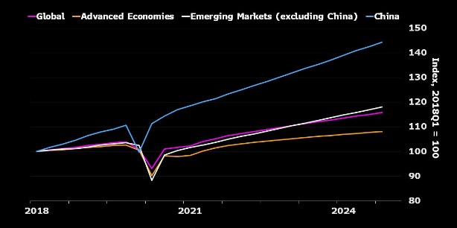
Big picture – China is far ahead of the pack

Slide 4
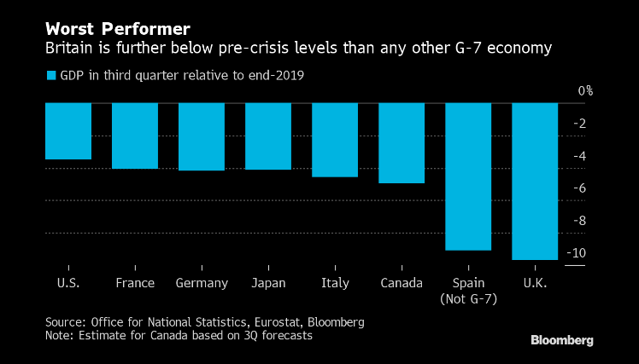
…and the UK has not done so well

Slide 5
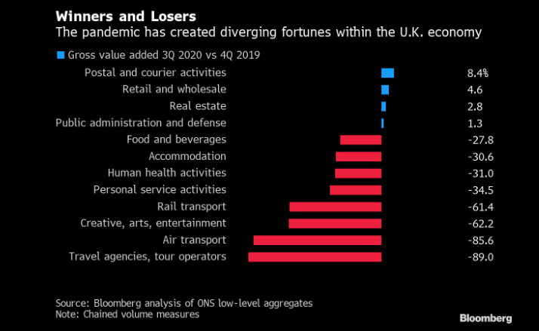
Not all in the same boat. At all.

